Slide 1
Expectation Maximization Algorithm
By Reid Offringa, PhD

Slide 2
Common Problem: Who are our customers?
Typical Solution:
Descriptive stats!
E.g. Mean age, Median weight
E.g. Standard deviation, range, 95% CI
Limitation:
Heterogenous dataset!
Segmentation?
Suppose the mean user age is 58
Marketing starts targeting 58 year olds!

Slide 3
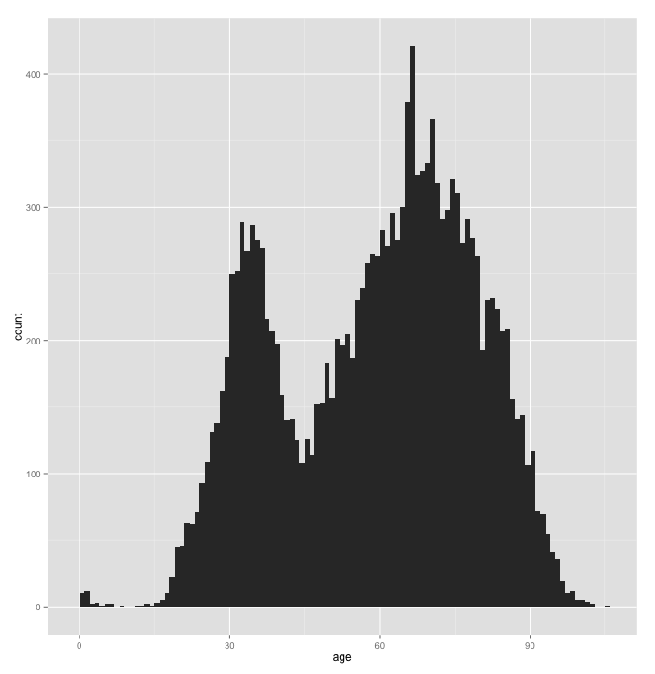
But wait a second…
Mean Age is 58

Slide 4
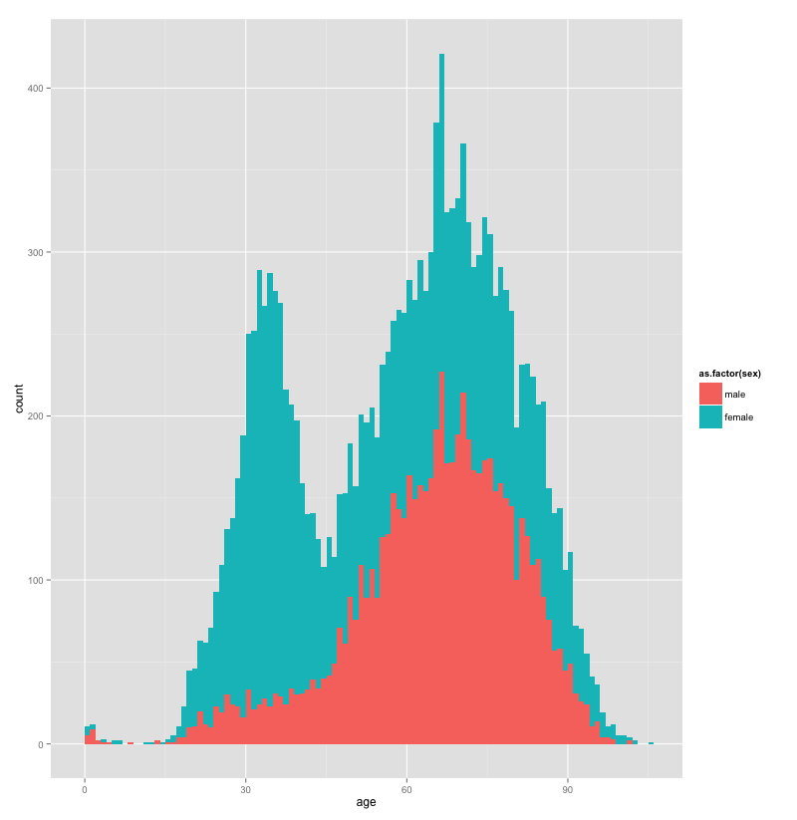
Let’s explore this further
Mean Age is 58
Females
Males

Slide 5
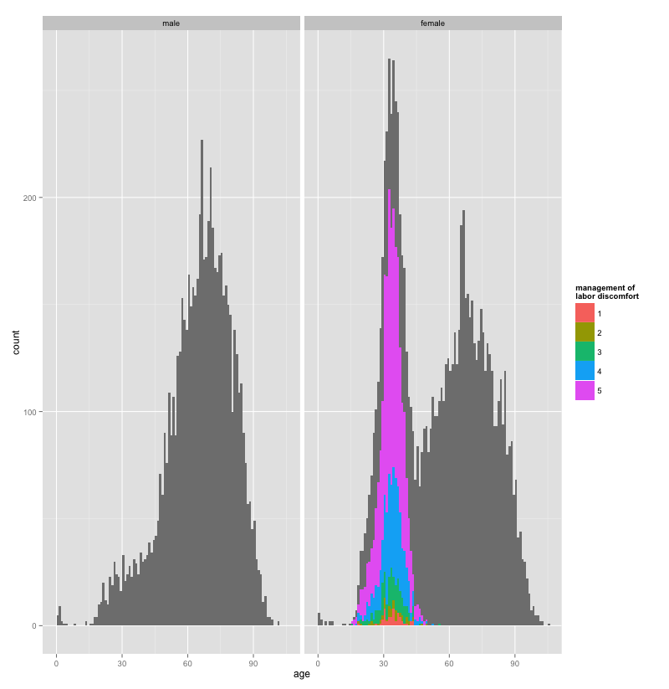
Oh! That makes sense
Males
Females
Reporting Labor Pain

Slide 6
Alternative to Graphing Everything : Latent Class Analysis
Take the same data
Extract Two Latent Classes
Latent Class 1, n=12,851
50% Female
Age 64.67
0% Reporting Labor Pain
Latent Class 2, n=2,963
100% Female
Age 32.09
78% Reporting Labor Pain

Slide 7
So, who are our customers?
Most are around 65
NOT 58!
Mix of males and females
But SOME are around 32
100% female!
That’s important!
They’re giving birth!
Not there for old age!
So, how does latent class analysis work?

Slide 8
Expectation Maximization!
Two steps
1) Expectation
2) Maximization
Basically, a guess and check loop

Slide 9
EM: What is it?
Two steps
1) Expectation
Given a guess for missing information
Returns ‘expected’ estimate
2) Maximization
Given ‘expected’ estimate
Optimize missing parameters

Slide 10
EM: What is it?
OK, sort of 3 steps
A) Initial random guess for missing info
1) Expectation
Given a guess for missing information
Returns ‘expected’ estimate
2) Maximization
Given ‘expected’ estimate
Optimize missing parameters

Slide 11
EM: Finding Maximum Likelihood
A) Initial random guess for ML
1) Expectation
Guess for the maximum likelihood
Returns a guess for the expected probabilities
2) Maximization
Given ‘expected’ probabilities
Calculates the maximum likelihood

Slide 12
Coin Flipping Example
A
B
P(Heads | A ) = 0.80
P(Heads | B ) = 0.45

Slide 13
Coin Flipping Example
A
Say we observe the following:
HHHHTHHHHH
Is it A or B?
What about:
HTTTHHTHTH
Is it A or B?
P(Heads | A ) = 0.80
B
P(Heads | B ) = 0.45

Slide 14
Coin Flipping Example
Don’t know group membership
1) HTTTH HTHTH
2) HHHHT HHHHH
3) HTHHH HHTHH
4) HTHTT THHTT
5) THHHT HHHTH
A
Don’t know this!
P(Heads | A ) = ??
B
We can automate these guesses!
With EM!
Don’t know this!
P(Heads | B ) = ??

Slide 15
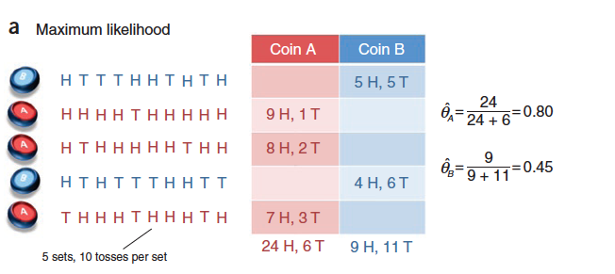
EASY IF YOU KNEW EVERYTHING

Slide 16
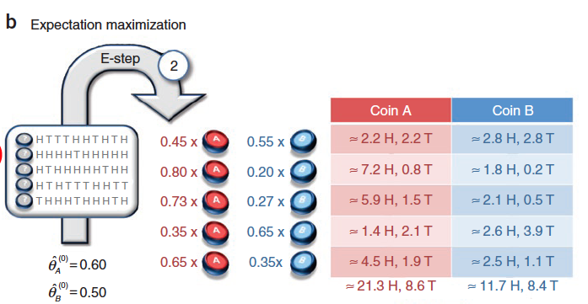
Expectation Step: OVERVIEW
First we make a guess!

Slide 17
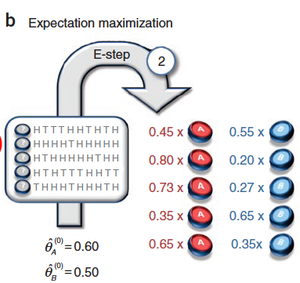
Expectation Step: Part 1
Assume observations are generated by some prior probability (theta)
Given theta sub A, what’s the P(A | o)?
Use binomial formula!
Then find the probability of an observation belonging to A, compared to B:
P(A|o)/[P(A|o)+P(B|o)]

Slide 18
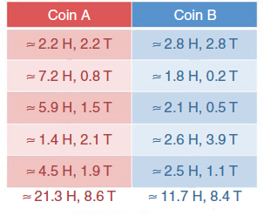
Expectation Step: Part 2
This formula generates a “weight” :
P(A|o)/[P(A|o)+P(B|o)]
For each observation:
Multiply weight by number of heads and tails.
Add them up
Produces a count of heads and tails
Weighted by probability of coin membership

Slide 19
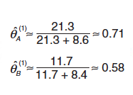
Maximization Step: ML from Weighted Count

Slide 20
Maximization Step: IF YOU KNEW EVERYTHING

Slide 21
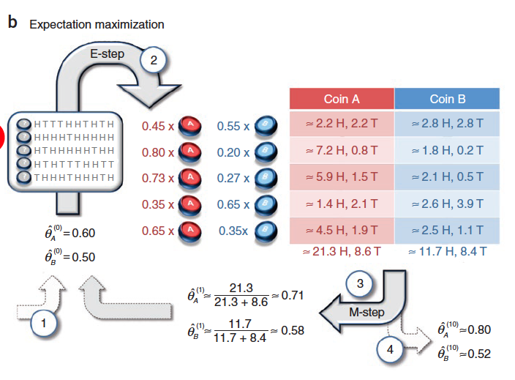
REPEAT

Slide 22
What uses the EM algorithm?
EM clustering
K-means clustering
sometimes called “Hard EM”
Latent class analysis
AKA mixture models
AKA Latent profile analysis
Item response theory
Probit regression

Slide 23
LECTURE OVER: Time for your in-class assignment!
Let’s go through the code!

